Slide 1
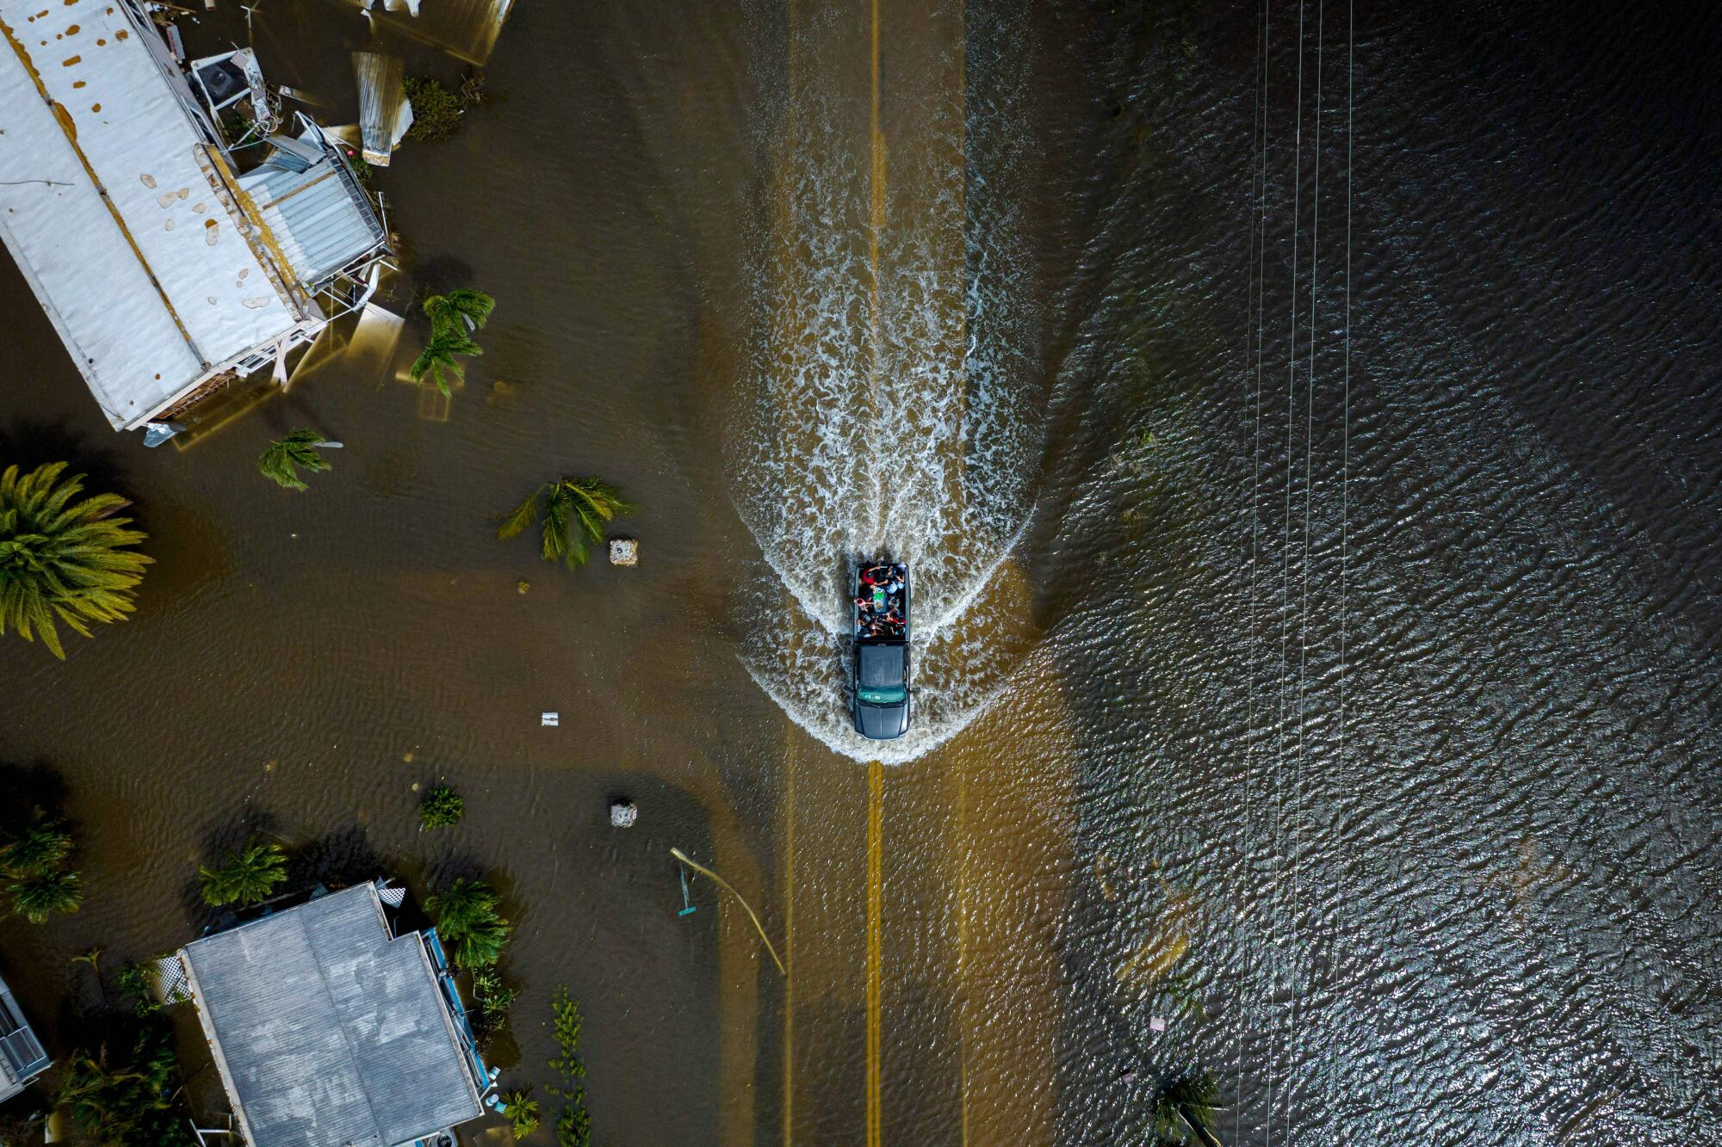
"Digital Logic Design for Hurricane Detection System"

Slide 2
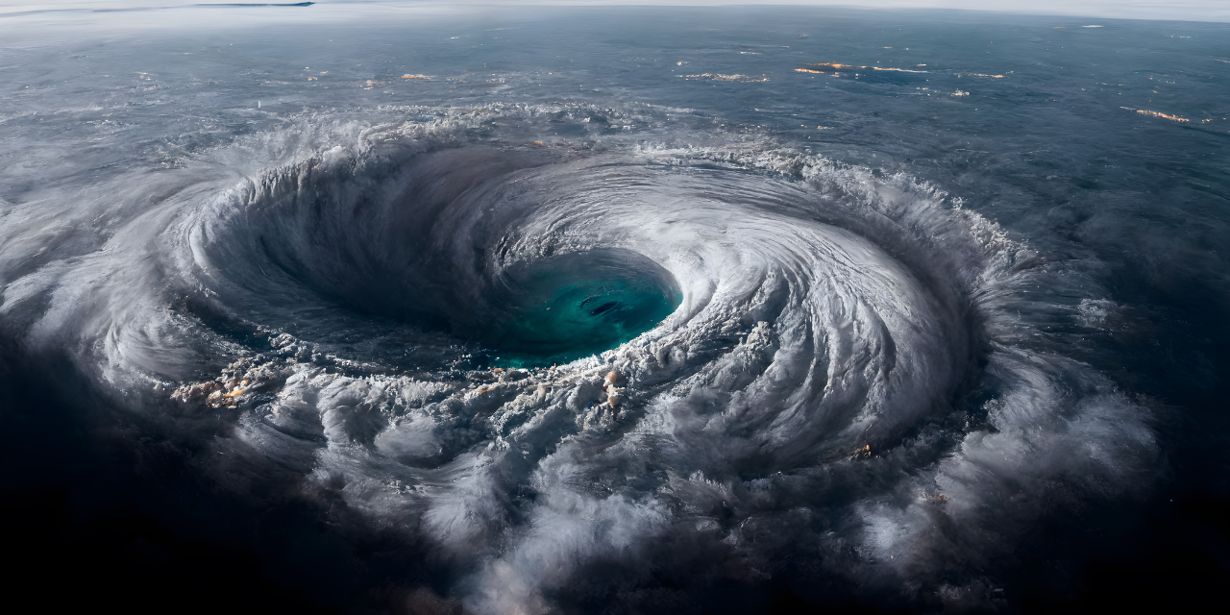
What Is Hurricane?
Hurricanes, known generically as tropical cyclones, are low-pressure systems with organized thunderstorm activity that form over tropical or subtropical waters. They gain their energy from warm ocean waters.

Slide 3
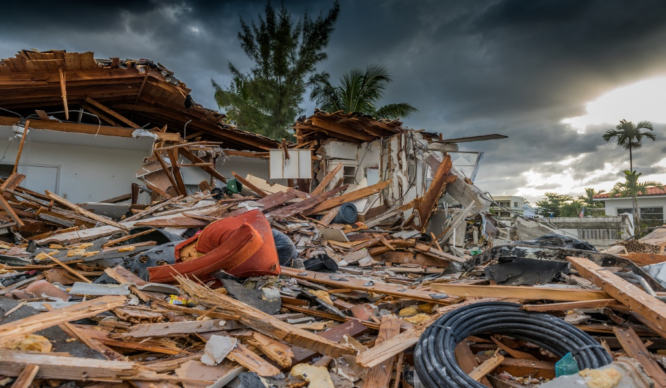
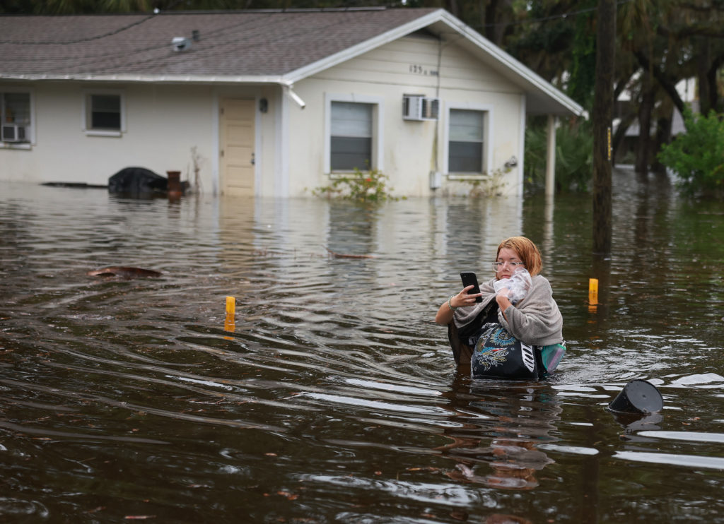
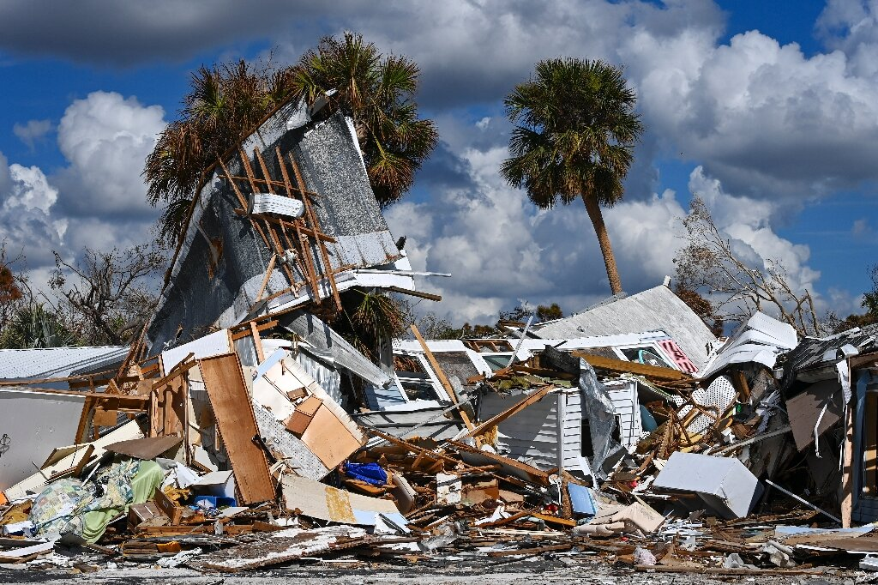
Why is a hurricane detection system necessary?
A hurricane detection system is essential for a number of reasons.
Detecting hurricanes early helps people prepare and evacuate, decreasing the risk of injury and loss of life.
Governments can mobilize resources and coordinate emergency response efforts more effectively when they have advance notice of an upcoming hurricane.
Understanding and tracking hurricanes is crucial for predicting their environmental impact, such as storm surges, flooding, and other ecological consequences..

Slide 4
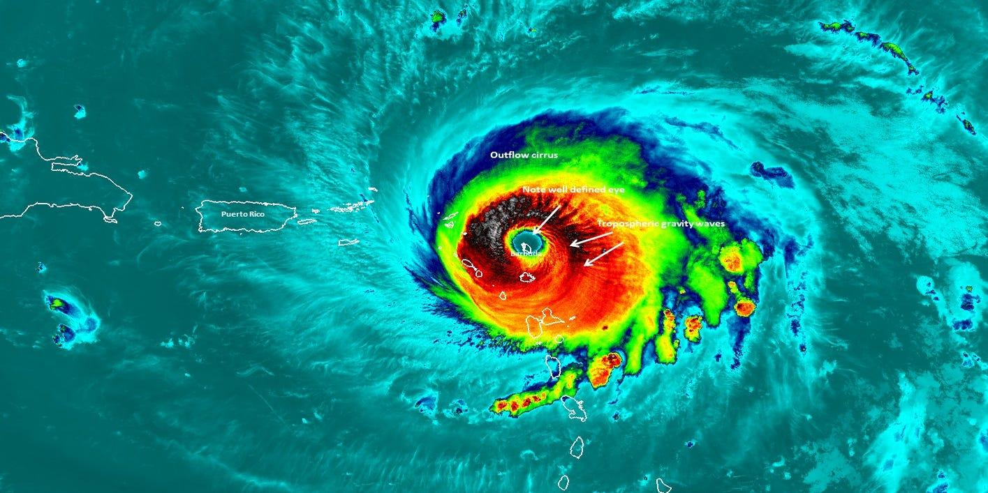
Digital Logic Design And Hurricane.
Here, we took help from ’’Digital Logic Design’’ to develop hurricane detection efficiency, focusing on early warning and disaster prevention.

Slide 5
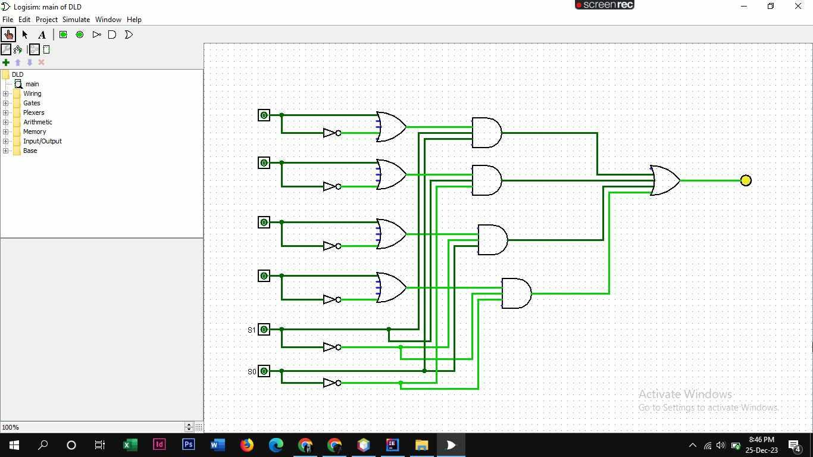
Circuit Design Of A Hurricane Detector:

Slide 6
Description Of The Circuit Design of Hurricane Detector:
Circuit description To build a hurricane detection system, 5 OR gates, 4 AND gates, and 6 NOT gates are used. 1 OR gate and 1 NOT gate are used to make a sensor. The sensors are used to detect the parameters. The output of the sensors is used as input for the multiplexer. The multiplexer is built using four AND gates and one OR gate. The output of the multiplexer is connected to a LED. The sensor gives an output of 1 when at least one of the inputs is 1. The sensor gives an output of 0 when all the inputs are zero. Each sensor takes two different conditions for a parameter into consideration. The multiplexer also takes the selection lines into consideration to generate a specific output.

Slide 7
Gate And Cost Calculation:
To build a simple hurricane detection system , six NOT gates, five OR gates, and four AND gates have been used. The costs of NOT,AND,OR gates , which are basic digital logic gates , are relatively low. The gates are fundamental components in electronic circuits and are widely available at affordable prices. The wires and the LED are widely available as well and are also inexpensive.

Slide 8
Conclusion
Digital logic design can significantly improve hurricane detection efficiency by formalizing algorithms, modeling patterns, and leveraging technology, thereby reducing the impact of hurricanes on susceptible locations.

Slide 9
Thanks!

Slide 10
GROUP MEMBERS:
1. NAME : MAHBUBA AKTER CHOWDHURY (223014183)
2.NAME : SENJUTI PAUL(223014048)
3.NAME : ISNAT JAHAN OME(223014050)
4.NAME : FATIMA WOHABEE(223014125)

